Slide 1
UPPER SIXTH ARTS
GEOGRAPHY
Map Analysis 6
Transport on Maps
Notes:
Good morning, class, and welcome to our geography lesson. I am your geography teacher, Mr Kamdem. Today we are starting Map Analysis 6: Transport on Maps.

Slide 2
CLASS INFO
Class, Chapter and Duration
Class | Upper Sixth Arts
Chapter | Module 8: Understanding and carrying out statistical techniques, topographic map analysis, fieldwork and project based learning
Duration | 2 periods (2 × 50 minutes)
Notes:
This lesson is for Upper Sixth Arts. It belongs to Module 8: Understanding and carrying out statistical techniques, topographic map analysis, fieldwork and project based learning. We shall need 2 periods to cover it.

Slide 3
IDENTIFICATION
Lesson Identification
Topic | Topographic Map Analysis
Sub-topic | Economic Activity Analysis
Lesson | Map Analysis 6: Transport on Maps
Notions / Concepts | Transport network, node, link, topological diagram, beta index, detour index.
Syllabus focus | Transport patterns and network types; topological diagrams; connectivity (nodes, links, beta index); detour index; relation of transport to relief and drainage.
Competence | Learners are able to analyse transport networks on maps with diagrams and indices.
Notes:
Our topic is Topographic Map Analysis, and the sub-topic is Economic Activity Analysis. The key notions we shall use today are: transport network, node, link, topological diagram, beta index, detour index. At the end, you should be able to do this: learners are able to analyse transport networks on maps with diagrams and indices.

Slide 4

HOMEWORK CORRECTION
Correction of the Homework
Question (Map Analysis 5: Vegetation on Maps):
Draw a sketch map of the vegetation types around your school.
Notes:
Before we start the new lesson, let us correct the homework I gave you at the end of Map Analysis 5: Vegetation on Maps. The question was: Draw a sketch map of the vegetation types around your school. Take out your exercise books.

Slide 5
HOMEWORK CORRECTION
Correction: Possible Answer
A good sketch shows a frame, title, key, scale and north arrow, with zones such as school garden, grass field, shade trees and bare ground.
Notes:
Here is a good answer. A good sketch shows a frame, title, key, scale and north arrow, with zones such as school garden, grass field, shade trees and bare ground. Compare it with your own answer and correct your work in red.

Slide 6
LESSON PLAN
Lesson Plan
Correction of the homework
Objectives and recall
Real-life situation and action to take
Learning activities
Board summary
Evaluation, remediation and homework
Notes:
Here is the plan of our lesson today. First, we shall correct the homework. Then we shall look at the objectives and recall what you already know. After that, we shall study a situation from real life and the action to take, and do the learning activities. Finally, we shall copy the board summary, do the evaluation and the remediation, and I will give you the homework.

Slide 7
OBJECTIVES
Objectives
By the end of this lesson, you should be able to:
Describe transport patterns on a map.
Draw a topological diagram and calculate the beta index.
Notes:
Take your time to copy this part; we will continue together.

Slide 8
OBJECTIVES
Objectives (continued)
Calculate the detour index and relate routes to relief.
Notes:
By the end of this lesson, you should be able to do three things. Number 1: describe transport patterns on a map. Number 2: draw a topological diagram and calculate the beta index. Number 3: calculate the detour index and relate routes to relief.

Slide 9
PREVIOUS KNOWLEDGE
Previous Knowledge
A network has nodes and links.
Beta index = links ÷ nodes.
Notes:
Let us first remember what you already know. A network has nodes and links. Beta index = links ÷ nodes. Keep this in mind, because we shall build on it today.

Slide 10
REAL-LIFE SITUATION
Situation in Real Life
On a map extract, two towns are separated by a hill. The road goes around the hill, while a footpath goes straight over it. The class must explain why.
Notes:
Listen carefully to this situation from real life. On a map extract, two towns are separated by a hill. The road goes around the hill, while a footpath goes straight over it. The class must explain why. Think about it, because I am going to ask you some questions.

Slide 11
REAL-LIFE SITUATION
Situation: Question 1
What is the problem in the situation?
Notes:
Question 1: What is the problem in the situation? Think for a moment, then raise your hand to answer.

Slide 12
REAL-LIFE SITUATION
Answer
The road does not take the shortest route.
Notes:
Good. The road does not take the shortest route.

Slide 13
REAL-LIFE SITUATION
Situation: Question 2
Why does the road go around?
Notes:
Question 2: Why does the road go around? Think for a moment, then raise your hand to answer.

Slide 14
REAL-LIFE SITUATION
Answer
To avoid the steep hill.
Notes:
Good. To avoid the steep hill.

Slide 15
REAL-LIFE SITUATION
Situation: Question 3
Which index measures this?
Notes:
Question 3: Which index measures this? Think for a moment, then raise your hand to answer.

Slide 16
REAL-LIFE SITUATION
Possible Answer
The detour index.
Notes:
Good. The detour index.

Slide 17
ACTION TO TAKE
Action to Take
Relate every route on the map to relief and drainage.
Notes:
From this situation, the action we are working towards in this lesson is the following: relate every route on the map to relief and drainage.

Slide 18
JUSTIFICATION
Justification of the Lesson
This lesson helps us to analyse and explain transport routes on maps.
Notes:
Why is this lesson important for you? This lesson helps us to analyse and explain transport routes on maps.

Slide 19
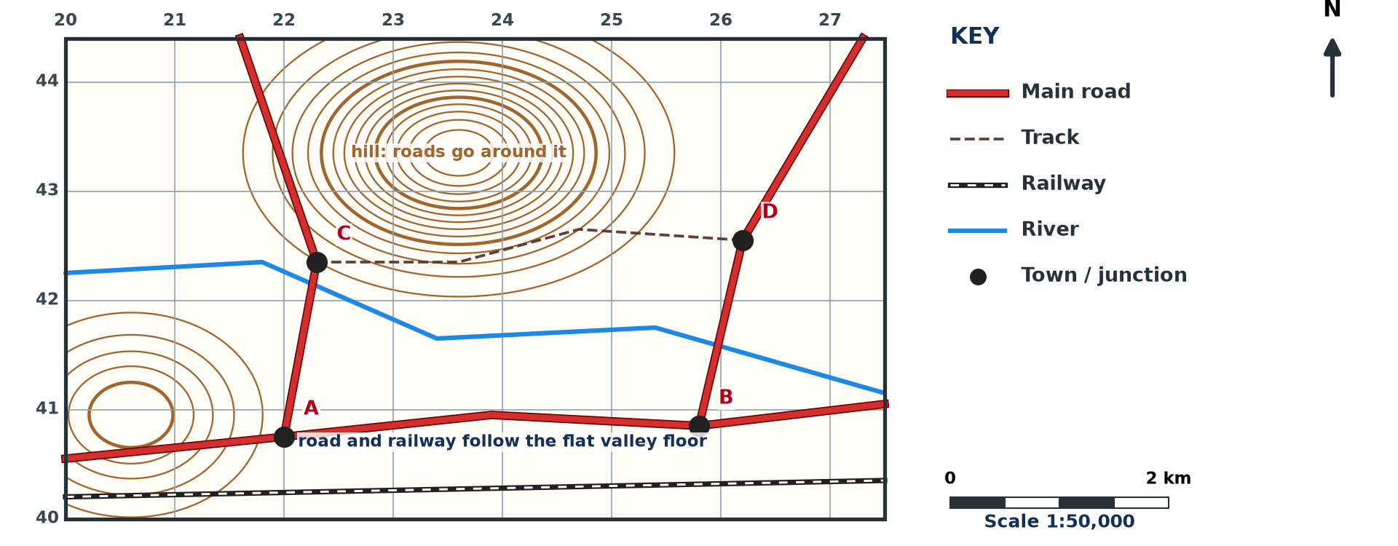
1. TRANSPORT PATTERNS
Activity 1
Transport on a map (invented).
Notes:
Activity 1. Look carefully at this diagram: transport on a map (invented). Observe every detail before I ask the question.

Slide 20
1. TRANSPORT PATTERNS
Activity 1: Question
Describe the transport network on the extract.
Notes:
Here is the question for Activity 1: Describe the transport network on the extract. Take one minute to think and write your answer in your rough notebook.

Slide 21
1. TRANSPORT PATTERNS
Activity 1: Answer
A main road and railway run east–west in the valley; two roads go north; a track links C and D.
Notes:
Let us check the answer together. A main road and railway run east–west in the valley; two roads go north; a track links C and D.

Slide 22
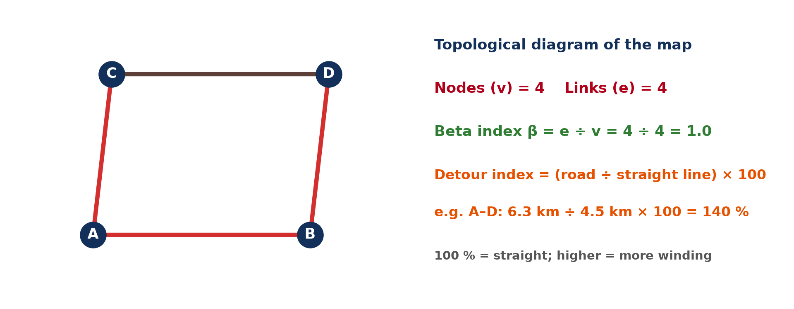
2. TOPOLOGICAL DIAGRAM
Activity 2
Topological diagram.
Notes:
Activity 2. Look carefully at this diagram: topological diagram. Observe every detail before I ask the question.

Slide 23
2. TOPOLOGICAL DIAGRAM
Activity 2: Question
What does a topological diagram show?
Notes:
Here is the question for Activity 2: What does a topological diagram show? Take one minute to think and write your answer in your rough notebook.

Slide 24
2. TOPOLOGICAL DIAGRAM
Activity 2: Answer
Only nodes and links, not true distances or shapes.
Notes:
Let us check the answer together. Only nodes and links, not true distances or shapes.

Slide 25

2. BETA INDEX
Activity 3
Beta index scale.
Notes:
Activity 3. Look carefully at this diagram: beta index scale. Observe every detail before I ask the question.

Slide 26
2. BETA INDEX
Activity 3: Question
Calculate β for 4 nodes and 4 links and interpret it.
Notes:
Here is the question for Activity 3: Calculate β for 4 nodes and 4 links and interpret it. Take one minute to think and write your answer in your rough notebook.

Slide 27
2. BETA INDEX
Activity 3: Answer
β = 4 ÷ 4 = 1.0: one circuit, fairly connected.
Notes:
Let us check the answer together. β = 4 ÷ 4 = 1.0: one circuit, fairly connected.

Slide 28
3. DETOUR INDEX
Activity 4
Detour index example.
Notes:
Activity 4. Look carefully at this diagram: detour index example. Observe every detail before I ask the question.

Slide 29
3. DETOUR INDEX
Activity 4: Question
A road is 6 km; the straight line is 4 km. Find the detour index.
Notes:
Here is the question for Activity 4: A road is 6 km; the straight line is 4 km. Find the detour index. Take one minute to think and write your answer in your rough notebook.

Slide 30
3. DETOUR INDEX
Activity 4: Answer
6 ÷ 4 × 100 = 150 %.
Notes:
Let us check the answer together. 6 ÷ 4 × 100 = 150 %.

Slide 31
4. RELIEF AND DRAINAGE
Activity 5
Routes and relief.
Notes:
Activity 5. Look carefully at this diagram: routes and relief. Observe every detail before I ask the question.

Slide 32
4. RELIEF AND DRAINAGE
Activity 5: Question
Give two ways relief influences routes on the map.
Notes:
Here is the question for Activity 5: Give two ways relief influences routes on the map. Take one minute to think and write your answer in your rough notebook.

Slide 33
4. RELIEF AND DRAINAGE
Activity 5: Answer
Routes follow flat valleys and go around hills.
Notes:
Let us check the answer together. Routes follow flat valleys and go around hills.

Slide 34
BOARD SUMMARY
Board Summary
Topic: Topographic Map Analysis
Sub-topic: Economic Activity Analysis
Map Analysis 6: Transport on Maps
Notes:
Now we are going to copy the board summary. Write the title and the headings neatly in your notebooks. I will give you enough time for each slide, so do not rush.

Slide 35
BOARD SUMMARY
1. Transport Patterns and Networks
Transport on a map is described as follows:
Types of routes: Maps show roads of different classes, railways, tracks, footpaths and airfields. The key distinguishes them by colour and width.
Notes:
Let us copy Transport Patterns and Networks. Transport on a map is described as follows. On this slide we have Types of routes. Write each point on a new line, with the key term first, and explain it in your own words when we revise. When you finish, we go to the next slide.

Slide 36
BOARD SUMMARY
1. Transport Patterns and Networks (continued)
Patterns: Routes may be linear along valleys, radial from a town or form a grid. Describe their direction, density and the places they link.
Notes:
We continue with Transport Patterns and Networks. On this slide we have Patterns. Write each point on a new line, with the key term first, and explain it in your own words when we revise.

Slide 37
BOARD SUMMARY
1. Transport Patterns and Networks
Illustration: transport on a map (invented)
Notes:
Now draw this illustration in your notebook: transport on a map (invented). Give it a title and label it clearly.

Slide 38
BOARD SUMMARY
2. Connectivity and Detour
The network is analysed with the following tools:
Topological diagram: It shows only nodes and links, without true distances or shapes. It makes a network easy to analyse.
Notes:
Let us copy Connectivity and Detour. The network is analysed with the following tools. On this slide we have Topological diagram. Write each point on a new line, with the key term first, and explain it in your own words when we revise. When you finish, we go to the next slide.

Slide 39
BOARD SUMMARY
2. Connectivity and Detour (continued)
Beta index: It is the number of links divided by the number of nodes. Below 1 the network is branching, and above 1 it has circuits.
Notes:
We continue with Connectivity and Detour. On this slide we have Beta index. Write each point on a new line, with the key term first, and explain it in your own words when we revise. When you finish, we go to the next slide.

Slide 40
BOARD SUMMARY
2. Connectivity and Detour (continued)
Detour index: It is the route distance divided by the straight-line distance, times 100. A value near 100 % shows a direct route.
Notes:
We continue with Connectivity and Detour. On this slide we have Detour index. Write each point on a new line, with the key term first, and explain it in your own words when we revise.

Slide 41
BOARD SUMMARY
2. Connectivity and Detour
Illustration: a topological diagram
Notes:
Now draw this illustration in your notebook: a topological diagram. Give it a title and label it clearly.

Slide 42
BOARD SUMMARY
3. Transport, Relief and Drainage
Relief and drainage influence routes as follows:
Relief: Routes follow flat valleys and gentle slopes and go round hills. Steep slopes make roads zigzag.
Notes:
Let us copy Transport, Relief and Drainage. Relief and drainage influence routes as follows. On this slide we have Relief. Write each point on a new line, with the key term first, and explain it in your own words when we revise. When you finish, we go to the next slide.

Slide 43
BOARD SUMMARY
3. Transport, Relief and Drainage (continued)
Drainage: Routes avoid swamps and cross rivers where they are narrow, at bridges or fords. Railways need even gentler gradients than roads.
Notes:
We continue with Transport, Relief and Drainage. On this slide we have Drainage. Write each point on a new line, with the key term first, and explain it in your own words when we revise.

Slide 44
FORMATIVE EVALUATION
Evaluation 1
A network has 7 links and 6 nodes. Find β.
Notes:
Now let us check what you have understood. Question 1: A network has 7 links and 6 nodes. Find β. Answer in your exercise book.

Slide 45
FORMATIVE EVALUATION
Expected Answer
7 ÷ 6 = 1.17: well connected.
Notes:
The expected answer is: 7 ÷ 6 = 1.17: well connected. If you got it right, well done.

Slide 46
FORMATIVE EVALUATION
Evaluation 2
Road 9 km, straight line 6 km: detour index?
Notes:
Now let us check what you have understood. Question 2: Road 9 km, straight line 6 km: detour index? Answer in your exercise book.

Slide 47
FORMATIVE EVALUATION
Expected Answer
9 ÷ 6 × 100 = 150 %.
Notes:
The expected answer is: 9 ÷ 6 × 100 = 150 %. If you got it right, well done.

Slide 48
REMEDIATION
Remediation
Fill in the blanks:
β = links ÷ ______.
A diagram of nodes and links is ______.
Routes follow ______ valleys.
Notes:
For those who need more practice, fill in the blanks in your exercise book. The answers are: number 1, nodes; number 2, topological; number 3, flat.

Slide 49
HOMEWORK
Homework
Draw a topological diagram of the roads in your town and calculate β.
Notes:
For your homework: Draw a topological diagram of the roads in your town and calculate β. We shall correct it at the beginning of our next lesson.

Slide 50
NEXT LESSON
Next Lesson
Our next lesson will be on:
Map Analysis 7: Land Use on Maps
Notes:
Our next lesson will be on Map Analysis 7: Land Use on Maps. Thank you for your attention, and see you next time.

Slide 51
BILINGUAL GAME
Bilingual Game (Jeu Bilingue)
English | Français
Network | Le réseau
Junction | Le carrefour
Railway | Le chemin de fer
Bridge | Le pont
Detour | Le détour
Track | La piste
Notes:
Let us play the bilingual game. I say a word in English, and you give me the French word. Then we do the reverse.

Slide 52
LOGBOOK
Official Logbook (1/2)
Module / Topic | Topographic Map Analysis
Lesson Title | Map Analysis 6: Transport on Maps
Expected Learning Outcomes | Describe transport patterns on a map. Draw a topological diagram and calculate the beta index. Calculate the detour index and relate routes to relief.
Competence | Learners are able to analyse transport networks on maps with diagrams and indices.
Notes:
I record this information in the official logbook of the class after the lesson.

Slide 53
LOGBOOK
Official Logbook (2/2)
Matter Taught | Transport Patterns and Networks; Connectivity and Detour; Transport, Relief and Drainage.
Evaluation | Formative evaluation and remediation exercise.
Homework | Draw a topological diagram of the roads in your town and calculate β.
Enrolment / Present / Absent | ____ / ____ / ____
Achievement | To be completed after the lesson.
Notes:
I complete the second page of the logbook: the matter taught, the evaluation, the homework and the attendance.

Slide 54
TEACHER'S NOTE
Teacher's Note
Timing: Homework correction, plan, objectives 8 min | Recall, situation, action 10 min | 5 activities 30 min | Board summary (copying) 30 min | Evaluation, remediation 10 min | Homework, next lesson 5 min | Logbook 7 min
Without the projector (Activity 1): describe the map.
Without the projector (Activity 2): draw the diagram.
Without the projector (Activity 3): calculate β.
Without the projector (Activity 4): calculate the index.
Without the projector (Activity 5): find evidence.
Notes:
This slide is for me, the teacher: it gives the timing of the lesson and what to do if the projector is not available.

Slide 55
REFERENCES
References
National Geography Syllabus, MINESEC/IGE/IP-SS, 2019 — Module 8 (Practical Geography).
Diagrams and animations: drawn for this lesson (Geography Department).
Notes:
These are the references and picture credits used to prepare this lesson.

